Slide 1
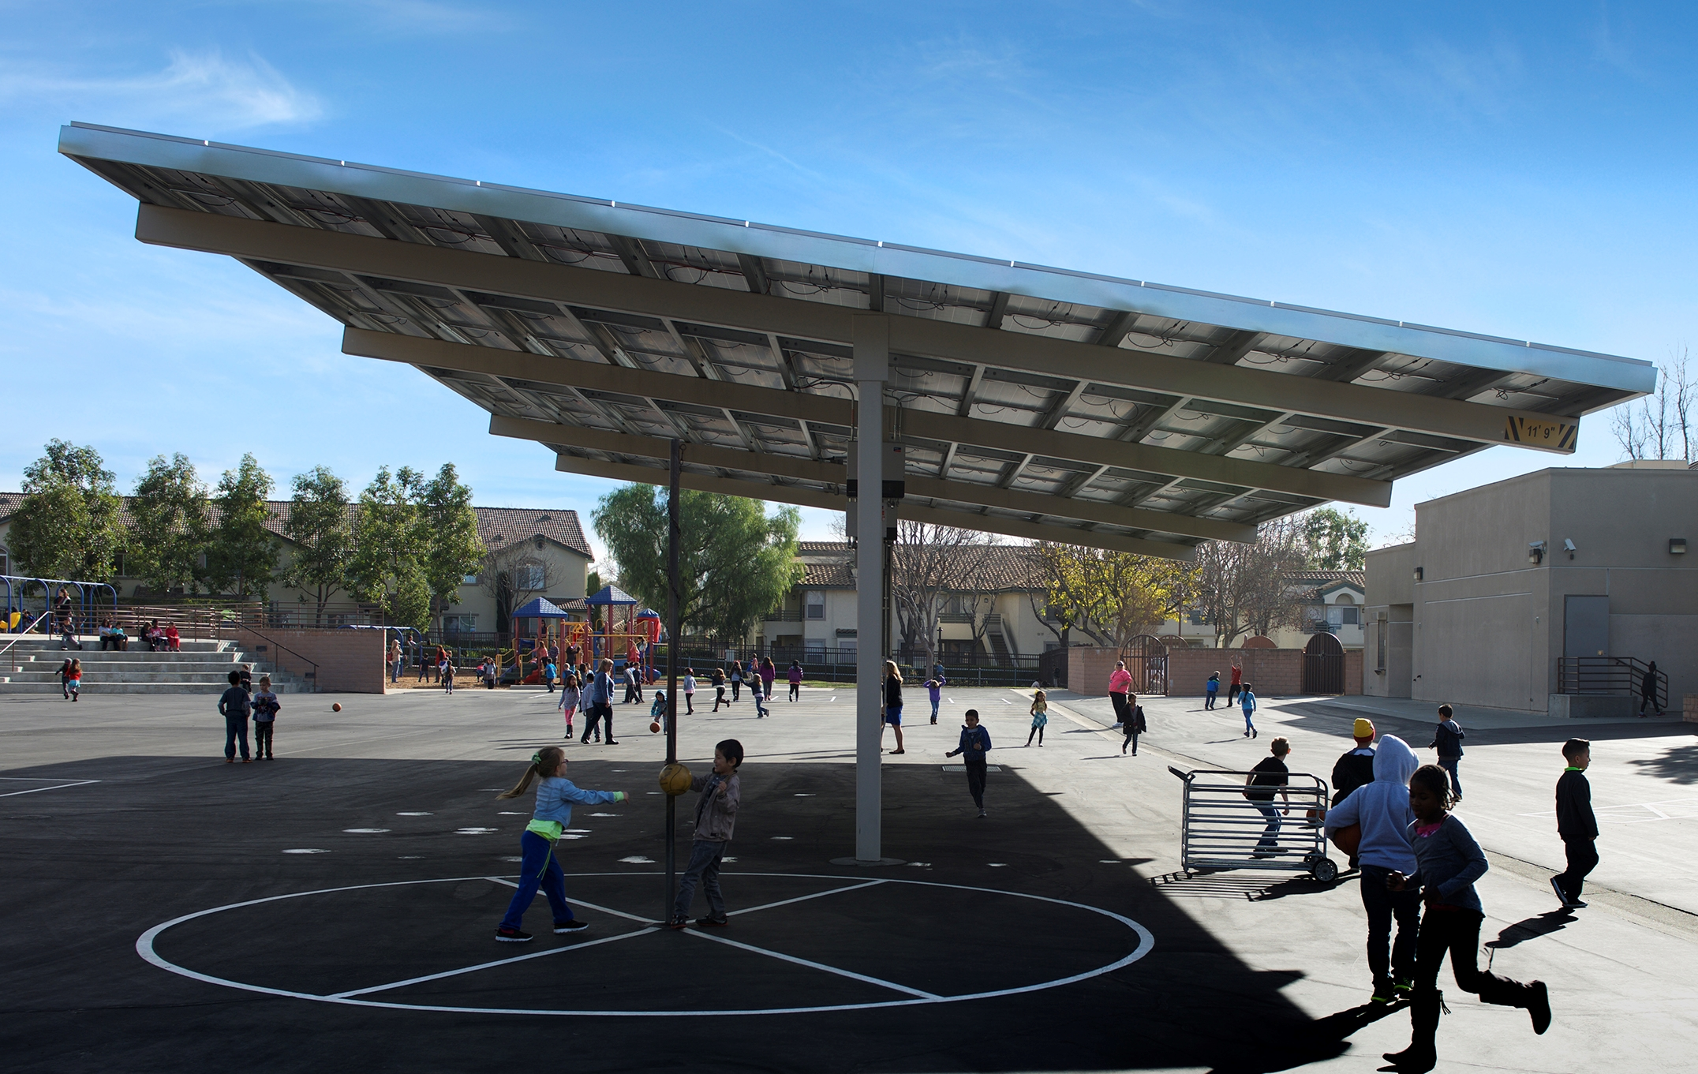
Proposed Placement of Photovoltaic “Solar” Shelters
Fullerton School District
Board of Education Meeting
March 12, 2019

Slide 2
What’s Our Why?
Need to replace aging lunch shelters
Need additional parking at the District Office
Need larger lunch shelters at various schools
Reducing future electric utility bills
Better for the environment
Will create shaded areas for outdoor learning
and recess
7. District is receiving over $4.5 million in lunch,
shade, and parking shelters at no cost

Slide 3
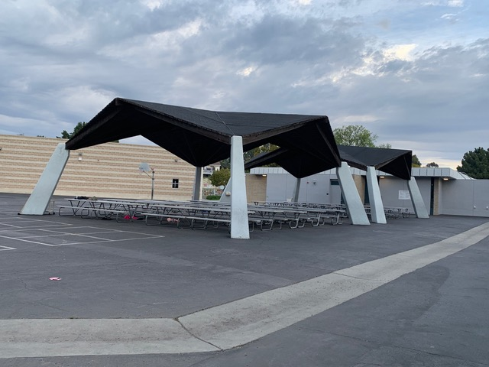
Remove Aging Lunch Shade Shelters
Remove 10 of our 14 aging lunch shelters at:
Pacific Drive (3)
Richman (3)
Rolling Hills (2)
Sunset Lane (2)
Cost to remove 10 aging lunch shelters $400,000 – No cost to the District

Slide 4
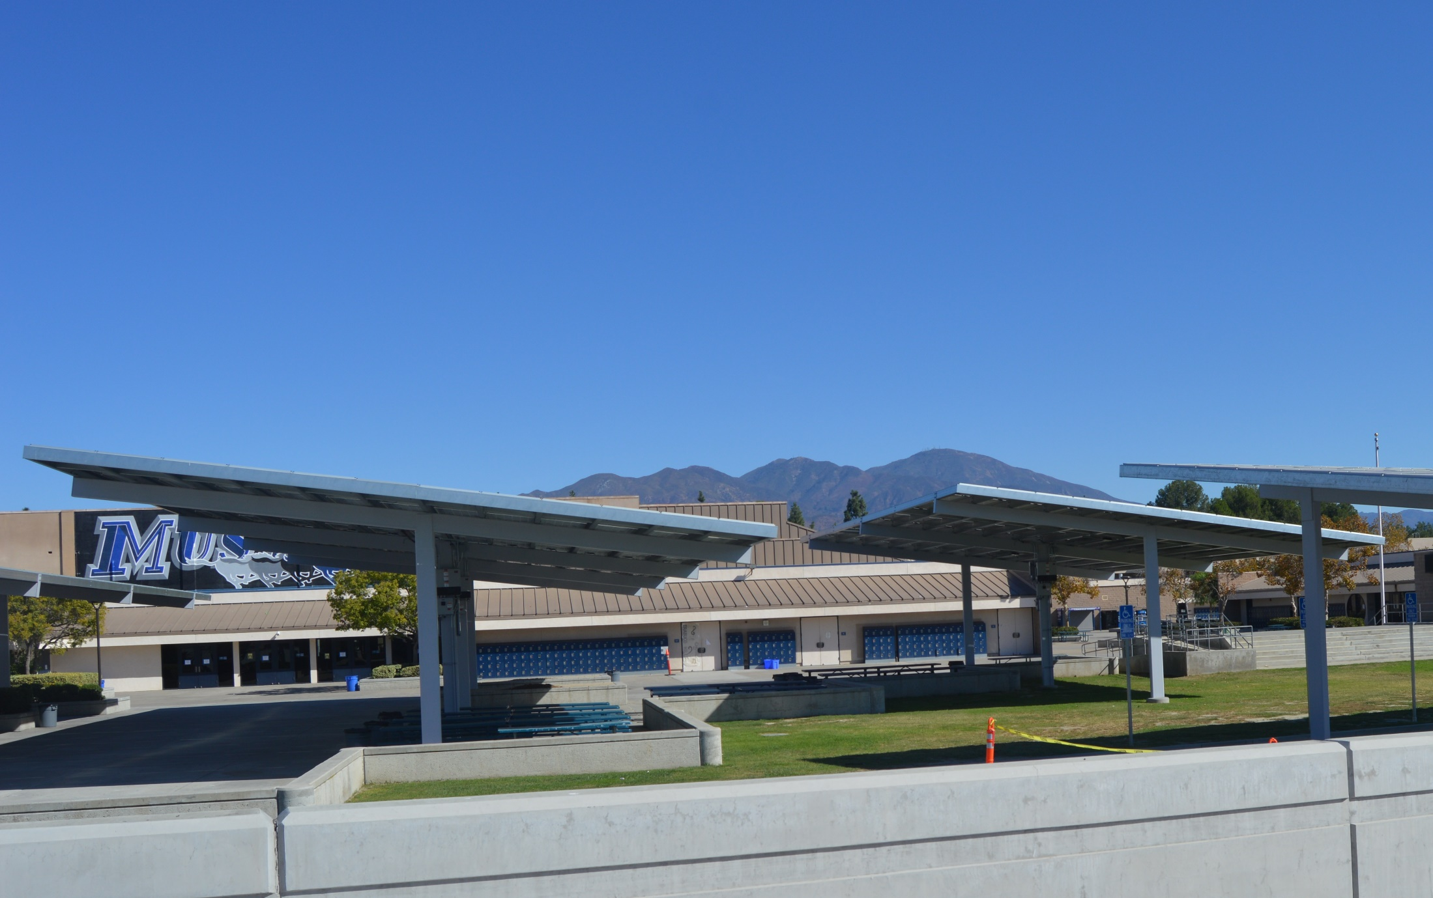
Lunch Shade Shelters
New Lunch Shelters at:
Pacific Drive
Richman
Rolling Hills
Sunset Lane
Hermosa (Larger)
Maple (Larger)
Raymond (Larger)
Cost to build these structures-$1.6 Mil-No cost to the District

Slide 5
Blacktop Shade Shelters
New Blacktop Shade Shelters at:
Acacia
Maple
Nicolas
Orangethorpe
Rolling Hills
Valencia Park
Woodcrest
Cost to build these structures-$0.6 Mil-No cost to the District

Slide 6
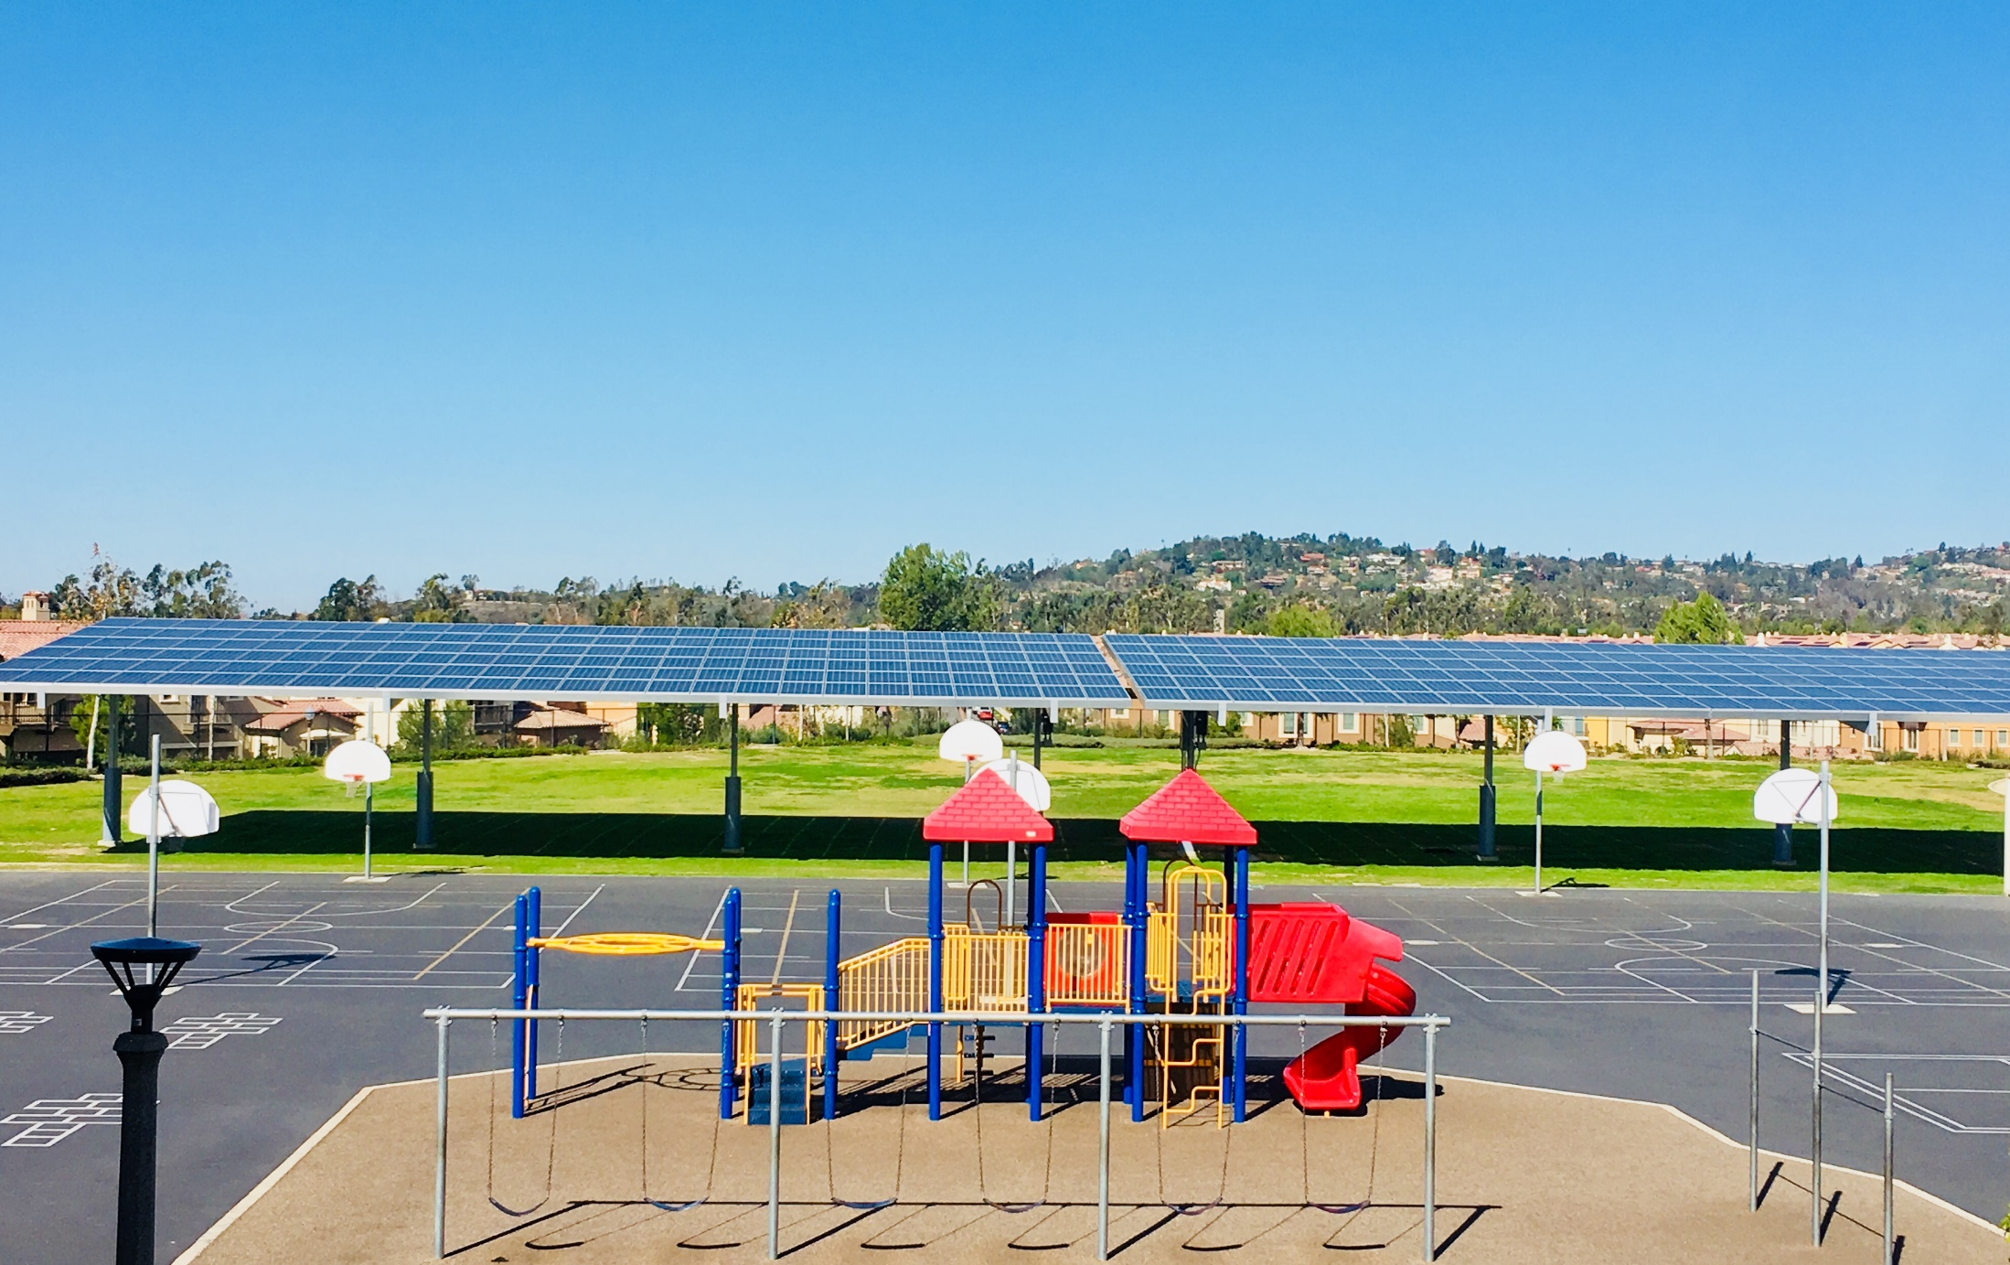
New Field Shade Shelters at:
Acacia
Beechwood
Commonwealth
Pacific Drive
Fern
Golden Hill
Ladera Vista
Laguna Road
Nicolas
Parks
Raymond
Sunset Lane
Valencia Park
Cost to build these structures-$1.2 Mil-No cost to the District
Field Shade Shelters

Slide 7
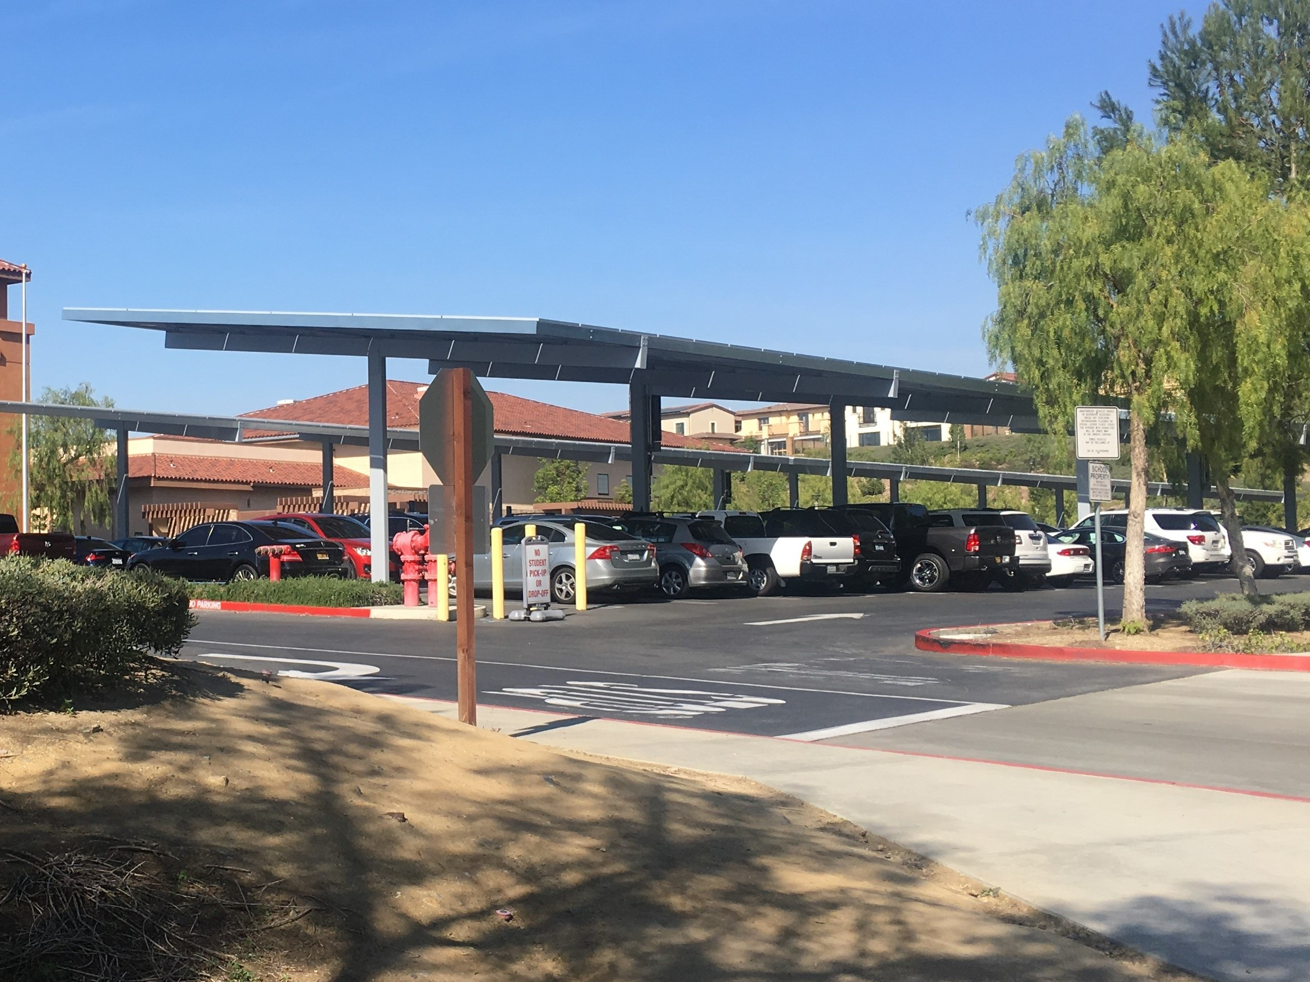
Parking Shade Shelters
New Parking Lot Shade Structure and EV Charging Stations:
District Office
Fisler
Richman
New Parking Lot
District Office
Cost to build these structures-$0.7 Mil-No cost to the District

Slide 8
PFMG Solar site walks to determine best placement
District and Maintenance reviewed PFMG recommendations
District met with each Site Leadership Team (Admin and Staff) to review placement criteria, present proposed locations and collaborate on possible alternative locations
11 of the 20 sites came up with alternatives
District shared alternatives with PFMG who was able to honor our changes

Slide 9
Placement Criteria of Photovoltaic Arrays
1. Requirements per DSA (Division of State Architects):
Solar panels can’t go on top of existing structures
(i.e. roofs, existing lunch shelters)
Solar panels must be at least 20 feet from any existing building
Solar panels can’t go over play ground equipment
Solar panels can’t go over existing easements
Solar panels can’t go over fire lanes
Solar structure needs to be ADA accessible
2. Solar panels need maximum exposure-no interference with shade from buildings or trees
3. Avoid placing Solar panels in the front of schools for aesthetic reasons
4. Replace displaced trees
5. Create usable shade space for students and community

Slide 11
SCHEMATIC LAYOUT OF PROPOSED SOLAR SYSTEM TABLE OF SOLAR ARRAYS TABLE OF UTILITY METERS Arrays were designed assuming a crystalline silicon PV module of nominal power = 385W Total estimated conduit length = 537 ft NOTES Results of easement reports may affect final placement of solar arrays Trees and/or other obstructions will have to be removed, trimmed or relocated A detailed analysis of the effect of shade on the arrays has not been performed A soil analysis has not been performed It is assumed that the site is not in a designated flood plain Arrays may be divided into 4,000sf sections with a 1' gap for earthquake safety
 |  |  | LEGEND |  | 7777 CENTER AVENUE, SUITE 200 HUNTINGTON BEACH CA 92647 (714) 408‐2982 WWW PFMGSOLAR.COM CONFIDENTIALITY STATEMENT This drawing is the property of PFMG Solar LLC and is not to be disclosed to others without written consent from PFMG Solar LLC
 |  |  |  | Solar Array
 |  |  |  | Point of Interconnection
 |  |  |  | Proposed Conduit Run
 |  |  |  | Tree to be removed. Final count may vary
Site Name: | Project name: | Site Address: |  | Revision: S02
ACACIA ELEMENTARY SCHOOL | FULLERTON SCHOOL DISTRICT | 1200 N ACACIA AVE FULLERTON, CA 92831 |  | Date: 2/8/2019 Drawn by: SAP
Location ID | Racking Type | Modules in Rise | # of Modules | Size DC kW | Azimuth | Tilt
A | Elevated | 6 | 126 | 48.510 | 270° | 7°
B | Elevated | 6 | 180 | 69.300 | 270° | 7°
 |  |  | 306 | 117.810
ACACIA ELEMENTARY
Location ID | Meter Name | Meter Number | # of Modules | Size DC kW | Connected to Arrays
 | Acacia ES | 259000-023981 | 306 | 117.810 | A,B
Z:\02_Projects\Fullerton School District\Engineering\Array Layouts\2018‐03‐10_Schematic\Acacia ES_S02_sap_2019‐02‐08.png
Full‐SD_SAS_v1.230_sp_2019‐02‐08.xlsm
Printed: 2/8/2019
87%
SAS Template Version: v110, Release Date: 01/22/2018

Slide 12
SCHEMATIC LAYOUT OF PROPOSED SOLAR SYSTEM TABLE OF SOLAR ARRAYS TABLE OF UTILITY METERS Arrays were designed assuming a crystalline silicon PV module of nominal power = 385W Total estimated conduit length = 839 ft NOTES Results of easement reports may affect final placement of solar arrays Trees and/or other obstructions will have to be removed, trimmed or relocated A detailed analysis of the effect of shade on the arrays has not been performed A soil analysis has not been performed It is assumed that the site is not in a designated flood plain Arrays may be divided into 4,000sf sections with a 1' gap for earthquake safety
 |  |  | LEGEND |  | 7777 CENTER AVENUE, SUITE 200 HUNTINGTON BEACH CA 92647 (714) 408‐2982 WWW PFMGSOLAR.COM CONFIDENTIALITY STATEMENT This drawing is the property of PFMG Solar LLC and is not to be disclosed to others without written consent from PFMG Solar LLC
 |  |  |  | Solar Array
 |  |  |  | Point of Interconnection
 |  |  |  | Proposed Conduit Run
 |  |  |  | Tree to be removed. Final count may vary
Site Name: | Project name: | Site Address: |  | Revision: S03
BEECHWOOD ELEMENTARY SCHOOL | FULLERTON SCHOOL DISTRICT | 780 BEECHWOOD AVE FULLERTON, CA 92835 |  | Date: 2/8/2019 Drawn by: SAP
Location ID | Racking Type | Modules in Rise | # of Modules | Size DC kW | Azimuth | Tilt
A | Elevated | 6 | 258 | 99.330 | 181° | 7°
B | Elevated | 6 | 180 | 69.300 | 270° | 7°
 |  |  | 438 | 168.630
BEECHWOOD
Location ID | Meter Name | Meter Number | # of Modules | Size DC kW | Connected to Arrays
 | Beechwood ES | V349N-008813 | 438 | 168.630 | A,B
Z:\02_Projects\Fullerton School District\Engineering\Array Layouts\2018‐03‐10_Schematic\Beechwood ES_S02_sap_2019‐02‐08.png
Full‐SD_SAS_v1.230_sp_2019‐02‐08.xlsm
Printed: 2/8/2019
85%
SAS Template Version: v110, Release Date: 01/22/2018

Slide 13
SCHEMATIC LAYOUT OF PROPOSED SOLAR SYSTEM TABLE OF SOLAR ARRAYS TABLE OF UTILITY METERS Arrays were designed assuming a crystalline silicon PV module of nominal power = 385W Total estimated conduit length = 433 ft NOTES Results of easement reports may affect final placement of solar arrays Trees and/or other obstructions will have to be removed, trimmed or relocated A detailed analysis of the effect of shade on the arrays has not been performed A soil analysis has not been performed It is assumed that the site is not in a designated flood plain Arrays may be divided into 4,000sf sections with a 1' gap for earthquake safety
 |  | LEGEND |  | 7777 CENTER AVENUE, SUITE 200 HUNTINGTON BEACH CA 92647 (714) 408‐2982 WWW PFMGSOLAR.COM CONFIDENTIALITY STATEMENT This drawing is the property of PFMG Solar LLC and is not to be disclosed to others without written consent from PFMG Solar LLC
 |  |  | Solar Array
 |  |  | Point of Interconnection
 |  |  | Proposed Conduit Run
 |  |  | Tree to be removed. Final count may vary
Site Name: | Project name: | Site Address: | Revision: S02
COMMONWEALTH ELEMENTARY SCHOOL | FULLERTON SCHOOL DISTRICT | 2200 E COMMONWEALTH AVE FULLERTON, CA 92831 | Date: 2/13/2019 Drawn by: SAP
Location ID | Racking Type | Modules in Rise | # of Modules | Size DC kW | Azimuth | Tilt
A | Elevated | 6 | 324 | 124.740 | 180° | 7°
 |  |  | 324 | 124.740
COMMONWEALTH ELEMENTARY
Location ID | Meter Name | Meter Number | # of Modules | Size DC kW | Connected to Arrays
 | Commonwealth ES | 259000-073203 | 324 | 124.740 | A
Z:\02_Projects\Fullerton School District\Engineering\Array Layouts\2019‐02‐08_Constrained\Commonwealth ES_S01_sap_2018‐3‐10.png
Full‐SD_SAS_v1.235_sp_2019‐02‐27.xlsm
Printed: 2/27/2019
86%
SAS Template Version: v110, Release Date: 01/22/2018

Slide 14
SCHEMATIC LAYOUT OF PROPOSED SOLAR SYSTEM TABLE OF SOLAR ARRAYS TABLE OF UTILITY METERS Arrays were designed assuming a crystalline silicon PV module of nominal power = 385W Total estimated conduit length = 1138 ft NOTES Results of easement reports may affect final placement of solar arrays Trees and/or other obstructions will have to be removed, trimmed or relocated A detailed analysis of the effect of shade on the arrays has not been performed A soil analysis has not been performed It is assumed that the site is not in a designated flood plain Arrays may be divided into 4,000sf sections with a 1' gap for earthquake safety
 |  |  | LEGEND |  | 7777 CENTER AVENUE, SUITE 200 HUNTINGTON BEACH CA 92647 (714) 408‐2982 WWW PFMGSOLAR.COM CONFIDENTIALITY STATEMENT This drawing is the property of PFMG Solar LLC and is not to be disclosed to others without written consent from PFMG Solar LLC
 |  |  |  | Solar Array
 |  |  |  | Point of Interconnection
 |  |  |  | Proposed Conduit Run
 |  |  |  | Tree to be removed. Final count may vary
Site Name: | Project name: | Site Address: |  | Revision: S06‐L
DISTRICT OFFICE AND PACIFIC DRIVE ELEMENTARY SCHOOL | FULLERTON SCHOOL DISTRICT | 1401 W VALENCIA DR FULLERTON, CA 92833 |  | Date: 2/13/2019 Drawn by: SAP
Location ID | Racking Type | Modules in Rise | # of Modules | Size DC kW | Azimuth | Tilt
D | Carport | 6 | 216 | 83.160 | 180° | 7°
E | Elevated | 6 | 396 | 152.460 | 270° | 7°
A | Elevated | 6 | 132 | 50.820 | 180° | 7°
B | Elevated | 6 | 132 | 50.820 | 180° | 7°
C | Elevated | 6 | 132 | 50.820 | 180° | 7°
 |  |  | 1,008 | 388.080
PACIFIC DRIVE, DISTRICT OFFICE
Location ID | Meter Name | Meter Number | # of Modules | Size DC kW | Connected to Arrays
2 | District Office 3 | 259000-041676 | 216 | 83.160 | D
3 | District Office 7 | 259000-039565 | 396 | 152.460 | E
1 | Pacific Drive ES | V349N-000365 | 396 | 152.460 | A,B,C
 |  |  | 1,008 | 388.080
Z:\02_Projects\Fullerton School District\Engineering\Array Layouts\2019‐02‐08_Constrained\District Office & Pacific Drive ES_S04_jsr_2018‐06‐26.pn Full‐SD_SAS_v1.233_sp_2019‐02‐13.xlsm
Printed: 2/14/2019
87%
86%
84%
SAS Template Version: v110, Release Date: 01/22/2018

Slide 15
SCHEMATIC LAYOUT OF PROPOSED SOLAR SYSTEM TABLE OF SOLAR ARRAYS TABLE OF UTILITY METERS Arrays were designed assuming a crystalline silicon PV module of nominal power = 385W Total estimated conduit length = 512 ft NOTES Results of easement reports may affect final placement of solar arrays Trees and/or other obstructions will have to be removed, trimmed or relocated A detailed analysis of the effect of shade on the arrays has not been performed A soil analysis has not been performed It is assumed that the site is not in a designated flood plain Arrays may be divided into 4,000sf sections with a 1' gap for earthquake safety
 |  |  | LEGEND |  | 7777 CENTER AVENUE, SUITE 200 HUNTINGTON BEACH CA 92647 (714) 408‐2982 WWW PFMGSOLAR.COM CONFIDENTIALITY STATEMENT This drawing is the property of PFMG Solar LLC and is not to be disclosed to others without written consent from PFMG Solar LLC
 |  |  |  | Solar Array
 |  |  |  | Point of Interconnection
 |  |  |  | Proposed Conduit Run
 |  |  |  | Tree to be removed. Final count may vary
Site Name: | Project name: | Site Address: |  | Revision: S02
FERN DRIVE ELEMENTARY SCHOOL | FULLERTON SCHOOL DISTRICT | 1400 W FERN DR FULLERTON, CA 92833 |  | Date: 3/21/2019 Drawn by: PMS
Location ID | Racking Type | Modules in Rise | # of Modules | Size DC kW | Azimuth | Tilt
A | Elevated | 6 | 216 | 83.160 | 180° | 7°
 |  |  | 216 | 83.160
FERN ELEMENTARY
Proposed New Placement 3/22/19
Location ID | Meter Name | Meter Number | # of Modules | Size DC kW | Connected to Arrays
 | Fern Drive ES | 259000-080549 | 216 | 83.160 | A
Z:\02_Projects\Fullerton School District\Engineering\Array Layouts\2019‐02‐08_Constrained\Fern Drive ES_S01_pms_2019‐03‐21.png
Full‐SD_SAS_v1.240_ps_2019‐03‐21.xlsm
Printed: 3/21/2019
82%
SAS Template Version: v110, Release Date: 01/22/2018

Slide 16
SCHEMATIC LAYOUT OF PROPOSED SOLAR SYSTEM TABLE OF SOLAR ARRAYS TABLE OF UTILITY METERS Arrays were designed assuming a crystalline silicon PV module of nominal power = 385W Total estimated conduit length = 164 ft NOTES Results of easement reports may affect final placement of solar arrays Trees and/or other obstructions will have to be removed, trimmed or relocated A detailed analysis of the effect of shade on the arrays has not been performed A soil analysis has not been performed It is assumed that the site is not in a designated flood plain Arrays may be divided into 4,000sf sections with a 1' gap for earthquake safety
 |  |  |  | LEGEND |  | 7777 CENTER AVENUE, SUITE 200 HUNTINGTON BEACH CA 92647 (714) 408‐2982 WWW PFMGSOLAR.COM CONFIDENTIALITY STATEMENT This drawing is the property of PFMG Solar LLC and is not to be disclosed to others without written consent from PFMG Solar LLC
 |  |  |  |  | Solar Array
 |  |  |  |  | Point of Interconnection
 |  |  |  |  | Proposed Conduit Run
 |  |  |  |  | Tree to be removed. Final count may vary
Site Name: |  | Project name: | Site Address: |  | Revision: S04‐L
FISLER ELEMENTARY SCHOOL |  | FULLERTON SCHOOL DISTRICT | 1350 STARBUCK ST FULLERTON, CA 92833 |  | Date: 2/8/2019 Drawn by: SAP
Location ID | Racking Type | Modules in Rise | # of Modules | Size DC kW | Azimuth | Tilt
A | Carport | 6 | 294 | 113.190 | 107° | 7°
B | Carport | 6 | 294 | 113.190 | 107° | 7°
 |  |  | 588 | 226.380
FISLER
Location ID | Meter Name | Meter Number | # of Modules | Size DC kW | Connected to Arrays
 | Fisler ES | V349N-000348 | 588 | 226.380 | A,B
Z:\02_Projects\Fullerton School District\Engineering\Array Layouts\2018‐03‐10_Schematic\Fisler ES_S03_jsr_2018‐04‐03.png
Full‐SD_SAS_v1.230_sp_2019‐02‐08.xlsm
Printed: 2/8/2019
78%
SAS Template Version: v110, Release Date: 01/22/2018

Slide 17
SCHEMATIC LAYOUT OF PROPOSED SOLAR SYSTEM TABLE OF SOLAR ARRAYS TABLE OF UTILITY METERS Arrays were designed assuming a crystalline silicon PV module of nominal power = 385W Total estimated conduit length = 293 ft NOTES Results of easement reports may affect final placement of solar arrays Trees and/or other obstructions will have to be removed, trimmed or relocated A detailed analysis of the effect of shade on the arrays has not been performed A soil analysis has not been performed It is assumed that the site is not in a designated flood plain Arrays may be divided into 4,000sf sections with a 1' gap for earthquake safety
 |  |  | LEGEND |  | 7777 CENTER AVENUE, SUITE 200 HUNTINGTON BEACH CA 92647 (714) 408‐2982 WWW PFMGSOLAR.COM CONFIDENTIALITY STATEMENT This drawing is the property of PFMG Solar LLC and is not to be disclosed to others without written consent from PFMG Solar LLC
 |  |  |  | Solar Array
 |  |  |  | Point of Interconnection
 |  |  |  | Proposed Conduit Run
 |  |  |  | Tree to be removed. Final count may vary
Site Name: | Project name: | Site Address: |  | Revision: S03
GOLDEN HILL ELEMENTARY SCHOOL | FULLERTON SCHOOL DISTRICT | 732 BARRIS DR FULLERTON, CA 92832 |  | Date: 2/13/2019 Drawn by: SAP
Location ID | Racking Type | Modules in Rise | # of Modules | Size DC kW | Azimuth | Tilt
A | Elevated | 6 | 312 | 120.120 | 261° | 7°
 |  |  | 312 | 120.120
GOLDEN HILL ELEMENTARY
Location ID | Meter Name | Meter Number | # of Modules | Size DC kW | Connected to Arrays
 | Golden Hill ES | 259000-084459 | 312 | 120.120 | A
Z:\02_Projects\Fullerton School District\Engineering\Array Layouts\2019‐02‐08_Constrained\Golden Hill ES_S02_sap_2018‐03‐11.png
Full‐SD_SAS_v1.233_sp_2019‐02‐13.xlsm
Printed: 2/14/2019
76%
SAS Template Version: v110, Release Date: 01/22/2018

Slide 18
SCHEMATIC LAYOUT OF PROPOSED SOLAR SYSTEM TABLE OF SOLAR ARRAYS TABLE OF UTILITY METERS Arrays were designed assuming a crystalline silicon PV module of nominal power = 385W Total estimated conduit length = 33 ft NOTES Results of easement reports may affect final placement of solar arrays Trees and/or other obstructions will have to be removed, trimmed or relocated A detailed analysis of the effect of shade on the arrays has not been performed A soil analysis has not been performed It is assumed that the site is not in a designated flood plain Arrays may be divided into 4,000sf sections with a 1' gap for earthquake safety
 |  |  | LEGEND |  | 7777 CENTER AVENUE, SUITE 200 HUNTINGTON BEACH CA 92647 (714) 408‐2982 WWW PFMGSOLAR.COM CONFIDENTIALITY STATEMENT This drawing is the property of PFMG Solar LLC and is not to be disclosed to others without written consent from PFMG Solar LLC
 |  |  |  | Solar Array
 |  |  |  | Point of Interconnection
 |  |  |  | Proposed Conduit Run
 |  |  |  | Tree to be removed. Final count may vary
Site Name: | Project name: | Site Address: |  | Revision: S02
HERMOSA DRIVE ELEMENTARY SCHOOL | FULLERTON SCHOOL DISTRICT | 400 E HERMOSA DR FULLERTON, CA 92835 |  | Date: 2/8/2019 Drawn by: SAP
Location ID | Racking Type | Modules in Rise | # of Modules | Size DC kW | Azimuth | Tilt
A | Elevated | 6 | 258 | 99.330 | 153° | 7°
 |  |  | 258 | 99.330
HERMOSA ELEMENTARY
Location ID | Meter Name | Meter Number | # of Modules | Size DC kW | Connected to Arrays
 | Hermosa Drive ES 1 | 259000-071826 | 258 | 99.330 | A
Z:\02_Projects\Fullerton School District\Engineering\Array Layouts\2018‐03‐10_Schematic\Hermosa Drive ES_S02_sap_2019‐01‐24.png
Full‐SD_SAS_v1.230_sp_2019‐02‐08.xlsm
Printed: 2/8/2019
85%
SAS Template Version: v110, Release Date: 01/22/2018

Slide 19
SCHEMATIC LAYOUT OF PROPOSED SOLAR SYSTEM TABLE OF SOLAR ARRAYS TABLE OF UTILITY METERS Arrays were designed assuming a crystalline silicon PV module of nominal power = 385W Total estimated conduit length = 560 ft NOTES Results of easement reports may affect final placement of solar arrays Trees and/or other obstructions will have to be removed, trimmed or relocated A detailed analysis of the effect of shade on the arrays has not been performed A soil analysis has not been performed It is assumed that the site is not in a designated flood plain Arrays may be divided into 4,000sf sections with a 1' gap for earthquake safety
 |  | LEGEND |  | 7777 CENTER AVENUE, SUITE 200 HUNTINGTON BEACH CA 92647 (714) 408‐2982 WWW PFMGSOLAR.COM CONFIDENTIALITY STATEMENT This drawing is the property of PFMG Solar LLC and is not to be disclosed to others without written consent from PFMG Solar LLC
 |  |  | Solar Array
 |  |  | Point of Interconnection
 |  |  | Proposed Conduit Run
 |  |  | Tree to be removed. Final count may vary
Site Name: | Project name: | Site Address: | Revision: S04
LADERA VISTA JUNIOR HIGH SCHOOL | FULLERTON SCHOOL DISTRICT | 1700 E COMMONWEALTH AVE FULLERTON, CA 92831 | Date: 2/13/2019 Drawn by: SAP
Location ID | Racking Type | Modules in Rise | # of Modules | Size DC kW | Azimuth | Tilt
A | Elevated | 6 | 360 | 138.600 | 199° | 7°
B | Elevated | 6 | 360 | 138.600 | 196° | 7°
 |  |  | 720 | 277.200
LADERA VISTA JUNIOR HIGH
Location ID | Meter Name | Meter Number | # of Modules | Size DC kW | Connected to Arrays
 | Ladera Vista JHS | V349N-017710 | 720 | 277.200 | A,B
Z:\02_Projects\Fullerton School District\Engineering\Array Layouts\2019‐02‐08_Constrained\Ladera Vista JHS_S03_sap_2019‐02‐08_option2.png
Full‐SD_SAS_v1.233_sp_2019‐02‐13.xlsm
Printed: 2/13/2019
83%
SAS Template Version: v110, Release Date: 01/22/2018

Slide 20
SCHEMATIC LAYOUT OF PROPOSED SOLAR SYSTEM TABLE OF SOLAR ARRAYS TABLE OF UTILITY METERS Arrays were designed assuming a crystalline silicon PV module of nominal power = 385W Total estimated conduit length = 351 ft NOTES Results of easement reports may affect final placement of solar arrays Trees and/or other obstructions will have to be removed, trimmed or relocated A detailed analysis of the effect of shade on the arrays has not been performed A soil analysis has not been performed It is assumed that the site is not in a designated flood plain Arrays may be divided into 4,000sf sections with a 1' gap for earthquake safety
 |  |  | LEGEND |  | 7777 CENTER AVENUE, SUITE 200 HUNTINGTON BEACH CA 92647 (714) 408‐2982 WWW PFMGSOLAR.COM CONFIDENTIALITY STATEMENT This drawing is the property of PFMG Solar LLC and is not to be disclosed to others without written consent from PFMG Solar LLC
 |  |  |  | Solar Array
 |  |  |  | Point of Interconnection
 |  |  |  | Proposed Conduit Run
 |  |  |  | Tree to be removed. Final count may vary
Site Name: | Project name: | Site Address: |  | Revision: S03
LAGUNA ROAD ELEMENTARY SCHOOL | FULLERTON SCHOOL DISTRICT | 300 LAGUNA RD FULLERTON, CA 92835 |  | Date: 2/27/2019 Drawn by: SAP
Location ID | Racking Type | Modules in Rise | # of Modules | Size DC kW | Azimuth | Tilt
A | Elevated | 6 | 360 | 138.600 | 113° | 7°
 |  |  | 360 | 138.600
LAGUNA ROAD ELEMENTARY
Location ID | Meter Name | Meter Number | # of Modules | Size DC kW | Connected to Arrays
 | Laguna Road ES | 259000-063238 | 360 | 138.600 | A
Z:\02_Projects\Fullerton School District\Engineering\Array Layouts\2019‐02‐08_Constrained\Laguna Road ES_S02_sap_2019‐02‐08.png
Full‐SD_SAS_v1.236_sp_2019‐02‐27.xlsm
Printed: 2/27/2019
83%
SAS Template Version: v110, Release Date: 01/22/2018

Slide 21
SCHEMATIC LAYOUT OF PROPOSED SOLAR SYSTEM TABLE OF SOLAR ARRAYS TABLE OF UTILITY METERS Arrays were designed assuming a crystalline silicon PV module of nominal power = 385W Total estimated conduit length = 98 ft NOTES Results of easement reports may affect final placement of solar arrays Trees and/or other obstructions will have to be removed, trimmed or relocated A detailed analysis of the effect of shade on the arrays has not been performed A soil analysis has not been performed It is assumed that the site is not in a designated flood plain Arrays may be divided into 4,000sf sections with a 1' gap for earthquake safety
 |  |  | LEGEND |  | 7777 CENTER AVENUE, SUITE 200 HUNTINGTON BEACH CA 92647 (714) 408‐2982 WWW PFMGSOLAR.COM CONFIDENTIALITY STATEMENT This drawing is the property of PFMG Solar LLC and is not to be disclosed to others without written consent from PFMG Solar LLC
 |  |  |  | Solar Array
 |  |  |  | Point of Interconnection
 |  |  |  | Proposed Conduit Run
 |  |  |  | Tree to be removed. Final count may vary
Site Name: | Project name: | Site Address: |  | Revision: S01‐L
MAPLE ELEMENTARY SCHOOL | FULLERTON SCHOOL DISTRICT | 244 E VALENCIA DR FULLERTON, CA 92832 |  | Date: 2/8/2019 Drawn by: SAP
Location ID | Racking Type | Modules in Rise | # of Modules | Size DC kW | Azimuth | Tilt
A | Elevated | 6 | 138 | 53.130 | 180° | 7°
B | Elevated | 6 | 138 | 53.130 | 180° | 7°
 |  |  | 276 | 106.260
MAPLE ELEMENTARY
Location ID | Meter Name | Meter Number | # of Modules | Size DC kW | Connected to Arrays
 | Maple ES | 259000-056151 | 276 | 106.260 | A,B
Z:\02_Projects\Fullerton School District\Engineering\Array Layouts\2018‐03‐10_Schematic\Maple ES_S01_sap_2018‐03‐11.png
Full‐SD_SAS_v1.230_sp_2019‐02‐08.xlsm
Printed: 2/8/2019
81%
SAS Template Version: v110, Release Date: 01/22/2018

Slide 22
SCHEMATIC LAYOUT OF PROPOSED SOLAR SYSTEM TABLE OF SOLAR ARRAYS TABLE OF UTILITY METERS Arrays were designed assuming a crystalline silicon PV module of nominal power = 385W Total estimated conduit length = 896 ft NOTES Results of easement reports may affect final placement of solar arrays Trees and/or other obstructions will have to be removed, trimmed or relocated A detailed analysis of the effect of shade on the arrays has not been performed A soil analysis has not been performed It is assumed that the site is not in a designated flood plain Arrays may be divided into 4,000sf sections with a 1' gap for earthquake safety
 |  |  | LEGEND |  | 7777 CENTER AVENUE, SUITE 200 HUNTINGTON BEACH CA 92647 (714) 408‐2982 WWW PFMGSOLAR.COM CONFIDENTIALITY STATEMENT This drawing is the property of PFMG Solar LLC and is not to be disclosed to others without written consent from PFMG Solar LLC
 |  |  |  | Solar Array
 |  |  |  | Point of Interconnection
 |  |  |  | Proposed Conduit Run
 |  |  |  | Tree to be removed. Final count may vary
Site Name: | Project name: | Site Address: |  | Revision: S03‐L
NICOLAS JUNIOR HIGH SCHOOL | FULLERTON SCHOOL DISTRICT | 1100 W OLIVE AVE FULLERTON, CA 92833 |  | Date: 2/22/2019 Drawn by: SAP
Location ID | Racking Type | Modules in Rise | # of Modules | Size DC kW | Azimuth | Tilt
A | Elevated | 6 | 360 | 138.600 | 270° | 7°
B | Elevated | 3 | 90 | 34.650 | 180° | 7°
 |  |  | 450 | 173.250
NICOLAS JUNIOR HIGH
Location ID | Meter Name | Meter Number | # of Modules | Size DC kW | Connected to Arrays
 | Nicolas JHS 1 | 359150-001234 | 450 | 173.250 | A,B
Z:\02_Projects\Fullerton School District\Engineering\Array Layouts\2019‐02‐08_Constrained\Nicolas JHS_S01_sap_2018‐03‐11.png
Full‐SD_SAS_v1.234_sp_2019‐02‐22.xlsm
Printed: 2/22/2019
74%
SAS Template Version: v110, Release Date: 01/22/2018

Slide 23
SCHEMATIC LAYOUT OF PROPOSED SOLAR SYSTEM TABLE OF SOLAR ARRAYS TABLE OF UTILITY METERS Arrays were designed assuming a crystalline silicon PV module of nominal power = 385W Total estimated conduit length = 608 ft NOTES Results of easement reports may affect final placement of solar arrays Trees and/or other obstructions will have to be removed, trimmed or relocated A detailed analysis of the effect of shade on the arrays has not been performed A soil analysis has not been performed It is assumed that the site is not in a designated flood plain Arrays may be divided into 4,000sf sections with a 1' gap for earthquake safety
 |  |  | LEGEND |  | 7777 CENTER AVENUE, SUITE 200 HUNTINGTON BEACH CA 92647 (714) 408‐2982 WWW PFMGSOLAR.COM CONFIDENTIALITY STATEMENT This drawing is the property of PFMG Solar LLC and is not to be disclosed to others without written consent from PFMG Solar LLC
 |  |  |  | Solar Array
 |  |  |  | Point of Interconnection
 |  |  |  | Proposed Conduit Run
 |  |  |  | Tree to be removed. Final count may vary
Site Name: | Project name: | Site Address: |  | Revision: S01‐L
ORANGETHORPE ELEMENTARY SCHOOL | FULLERTON SCHOOL DISTRICT | 1400 S BROOKHURST RD FULLERTON, CA 92833 |  | Date: 2/8/2019 Drawn by: SAP
Location ID | Racking Type | Modules in Rise | # of Modules | Size DC kW | Azimuth | Tilt
A | Elevated | 6 | 168 | 64.680 | 180° | 7°
B | Elevated | 6 | 168 | 64.680 | 180° | 7°
 |  |  | 336 | 129.360
ORANGETHORPE ELEMENTARY
Location ID | Meter Name | Meter Number | # of Modules | Size DC kW | Connected to Arrays
 | Orangethorpe ES 2 | V349N-011990 | 336 | 129.360 | A,B
Z:\02_Projects\Fullerton School District\Engineering\Array Layouts\2018‐03‐10_Schematic\Orangethorpe ES_S01_sap_2018‐03‐11.png
Full‐SD_SAS_v1.230_sp_2019‐02‐08.xlsm
Printed: 2/8/2019
85%
SAS Template Version: v110, Release Date: 01/22/2018

Slide 24
SCHEMATIC LAYOUT OF PROPOSED SOLAR SYSTEM TABLE OF SOLAR ARRAYS TABLE OF UTILITY METERS Arrays were designed assuming a crystalline silicon PV module of nominal power = 385W Total estimated conduit length = 778 ft NOTES Results of easement reports may affect final placement of solar arrays Trees and/or other obstructions will have to be removed, trimmed or relocated A detailed analysis of the effect of shade on the arrays has not been performed A soil analysis has not been performed It is assumed that the site is not in a designated flood plain Arrays may be divided into 4,000sf sections with a 1' gap for earthquake safety
 |  |  |  | LEGEND |  | 7777 CENTER AVENUE, SUITE 200 HUNTINGTON BEACH CA 92647 (714) 408‐2982 WWW PFMGSOLAR.COM CONFIDENTIALITY STATEMENT This drawing is the property of PFMG Solar LLC and is not to be disclosed to others without written consent from PFMG Solar LLC
 |  |  |  |  | Solar Array
 |  |  |  |  | Point of Interconnection
 |  |  |  |  | Proposed Conduit Run
 |  |  |  |  | Tree to be removed. Final count may vary
Site Name: |  | Project name: | Site Address: |  | Revision: S01
PARKS JUNIOR HIGH SCHOOL |  | FULLERTON SCHOOL DISTRICT | 1710 ROSECRANS AVE FULLERTON, CA 92833 |  | Date: 2/8/2019 Drawn by: SAP
Location ID | Racking Type | Modules in Rise | # of Modules | Size DC kW | Azimuth | Tilt
A | Elevated | 6 | 522 | 200.970 | 90° | 7°
 |  |  | 522 | 200.970
PARKS JUNIOR HIGH
Location ID | Meter Name | Meter Number | # of Modules | Size DC kW | Connected to Arrays
 | Parks JHS | V349N-003848 | 522 | 200.970 | A
Z:\02_Projects\Fullerton School District\Engineering\Array Layouts\2018‐03‐10_Schematic\Parks JHS_S01_sap_2018‐03‐11.png
Full‐SD_SAS_v1.231_sp_2019‐02‐11.xlsm
Printed: 2/11/2019
85%
SAS Template Version: v110, Release Date: 01/22/2018

Slide 25
SCHEMATIC LAYOUT OF PROPOSED SOLAR SYSTEM TABLE OF SOLAR ARRAYS TABLE OF UTILITY METERS Arrays were designed assuming a crystalline silicon PV module of nominal power = 385W Total estimated conduit length = 613 ft NOTES Results of easement reports may affect final placement of solar arrays Trees and/or other obstructions will have to be removed, trimmed or relocated A detailed analysis of the effect of shade on the arrays has not been performed A soil analysis has not been performed It is assumed that the site is not in a designated flood plain Arrays may be divided into 4,000sf sections with a 1' gap for earthquake safety
 |  |  | LEGEND |  | 7777 CENTER AVENUE, SUITE 200 HUNTINGTON BEACH CA 92647 (714) 408‐2982 WWW PFMGSOLAR.COM CONFIDENTIALITY STATEMENT This drawing is the property of PFMG Solar LLC and is not to be disclosed to others without written consent from PFMG Solar LLC
 |  |  |  | Solar Array
 |  |  |  | Point of Interconnection
 |  |  |  | Proposed Conduit Run
 |  |  |  | Tree to be removed. Final count may vary
Site Name: | Project name: | Site Address: |  | Revision: S05
RAYMOND ELEMENTARY SCHOOL | FULLERTON SCHOOL DISTRICT | 517 N RAYMOND FULLERTON, CA 92831 |  | Date: 2/22/2019 Drawn by: SAP
Location ID | Racking Type | Modules in Rise | # of Modules | Size DC kW | Azimuth | Tilt
A | Elevated | 6 | 180 | 69.300 | 180° | 7°
B | Elevated | 3 | 72 | 27.720 | 180° | 7°
 |  |  | 252 | 97.020
RAYMOND ELEMENTARY
Location ID | Meter Name | Meter Number | # of Modules | Size DC kW | Connected to Arrays
 | Raymond ES | 259000-070156 | 252 | 97.020 | A,B
Z:\02_Projects\Fullerton School District\Engineering\Array Layouts\2019‐02‐08_Constrained\Raymond ES_S04_sap_2019‐02‐08.png
Full‐SD_SAS_v1.234_sp_2019‐02‐22.xlsm
Printed: 2/22/2019
80%
SAS Template Version: v110, Release Date: 01/22/2018

Slide 26
SCHEMATIC LAYOUT OF PROPOSED SOLAR SYSTEM TABLE OF SOLAR ARRAYS TABLE OF UTILITY METERS Arrays were designed assuming a crystalline silicon PV module of nominal power = 385W Total estimated conduit length = 1116 ft NOTES Results of easement reports may affect final placement of solar arrays Trees and/or other obstructions will have to be removed, trimmed or relocated A detailed analysis of the effect of shade on the arrays has not been performed A soil analysis has not been performed It is assumed that the site is not in a designated flood plain Arrays may be divided into 4,000sf sections with a 1' gap for earthquake safety
 |  |  | LEGEND |  | 7777 CENTER AVENUE, SUITE 200 HUNTINGTON BEACH CA 92647 (714) 408‐2982 WWW PFMGSOLAR.COM CONFIDENTIALITY STATEMENT This drawing is the property of PFMG Solar LLC and is not to be disclosed to others without written consent from PFMG Solar LLC
 |  |  |  | Solar Array
 |  |  |  | Point of Interconnection
 |  |  |  | Proposed Conduit Run
 |  |  |  | Tree to be removed. Final count may vary
Site Name: | Project name: | Site Address: |  | Revision: S04‐L
RICHMAN ELEMENTARY SCHOOL | FULLERTON SCHOOL DISTRICT | 700 S RICHMOND AVE FULLERTON, CA 92832 |  | Date: 2/13/2019 Drawn by: SAP
Location ID | Racking Type | Modules in Rise | # of Modules | Size DC kW | Azimuth | Tilt
A | Carport | 6 | 258 | 99.330 | 270° | 7°
B | Elevated | 6 | 162 | 62.370 | 272° | 7°
 |  |  | 420 | 161.700
RICHMAN ELEMENTARY
Location ID | Meter Name | Meter Number | # of Modules | Size DC kW | Connected to Arrays
 | Richman ES | V349N-007764 | 420 | 161.700 | A,B
Z:\02_Projects\Fullerton School District\Engineering\Array Layouts\2019‐02‐08_Constrained\Richman ES_S03_sap_2019‐02‐08.png
Full‐SD_SAS_v1.232_sp_2019‐02‐13.xlsm
Printed: 2/13/2019
76%
SAS Template Version: v110, Release Date: 01/22/2018

Slide 27
SCHEMATIC LAYOUT OF PROPOSED SOLAR SYSTEM TABLE OF SOLAR ARRAYS TABLE OF UTILITY METERS Arrays were designed assuming a crystalline silicon PV module of nominal power = 385W Total estimated conduit length = 425 ft NOTES Results of easement reports may affect final placement of solar arrays Trees and/or other obstructions will have to be removed, trimmed or relocated A detailed analysis of the effect of shade on the arrays has not been performed A soil analysis has not been performed It is assumed that the site is not in a designated flood plain Arrays may be divided into 4,000sf sections with a 1' gap for earthquake safety
 |  |  | LEGEND |  | 7777 CENTER AVENUE, SUITE 200 HUNTINGTON BEACH CA 92647 (714) 408‐2982 WWW PFMGSOLAR.COM CONFIDENTIALITY STATEMENT This drawing is the property of PFMG Solar LLC and is not to be disclosed to others without written consent from PFMG Solar LLC
 |  |  |  | Solar Array
 |  |  |  | Point of Interconnection
 |  |  |  | Proposed Conduit Run
 |  |  |  | Tree to be removed. Final count may vary
Site Name: | Project name: | Site Address: |  | Revision: S04
ROLLING HILLS ELEMENTARY SCHOOL | FULLERTON SCHOOL DISTRICT | 1460 ROLLING HILLS DR FULLERTON, CA 92835 |  | Date: 2/13/2019 Drawn by: SAP
Location ID | Racking Type | Modules in Rise | # of Modules | Size DC kW | Azimuth | Tilt
A | Elevated | 6 | 180 | 69.300 | 180° | 7°
B | Elevated | 6 | 150 | 57.750 | 180° | 7°
 |  |  | 330 | 127.050
ROLLING HILLS ELEMENTARY
Location ID | Meter Name | Meter Number | # of Modules | Size DC kW | Connected to Arrays
 | Rolling Hills ES 2 | 259000-077470 | 330 | 127.050 | A,B
Z:\02_Projects\Fullerton School District\Engineering\Array Layouts\2019‐02‐08_Constrained\Rolling Hills ES_S03_sap_2019‐02‐08.png
Full‐SD_SAS_v1.232_sp_2019‐02‐13.xlsm
Printed: 2/13/2019
82%
SAS Template Version: v110, Release Date: 01/22/2018

Slide 28
SCHEMATIC LAYOUT OF PROPOSED SOLAR SYSTEM TABLE OF SOLAR ARRAYS TABLE OF UTILITY METERS Arrays were designed assuming a crystalline silicon PV module of nominal power = 385W Total estimated conduit length = 258 ft NOTES Results of easement reports may affect final placement of solar arrays Trees and/or other obstructions will have to be removed, trimmed or relocated A detailed analysis of the effect of shade on the arrays has not been performed A soil analysis has not been performed It is assumed that the site is not in a designated flood plain Arrays may be divided into 4,000sf sections with a 1' gap for earthquake safety
 |  |  | LEGEND |  | 7777 CENTER AVENUE, SUITE 200 HUNTINGTON BEACH CA 92647 (714) 408-2982 WWW PFMGSOLAR.COM CONFIDENTIALITY STATEMENT This drawing is the property of PFMG Solar LLC and is not to be disclosed to others without written consent from PFMG Solar LLC
 |  |  |  | Solar Array
 |  |  |  | Point of Interconnection
 |  |  |  | Proposed Conduit Run
 |  |  |  | Tree to be removed. Final count may vary
Site Name: | Project name: | Site Address: |  | Revision: S01
SUNSET LANE ELEMENTARY SCHOOL | FULLERTON SCHOOL DISTRICT | 2030 SUNSET LN FULLERTON, CA 92833 |  | Date: 3/7/2019 Drawn by: PMS
Location ID | Racking Type | Modules in Rise | # of Modules | Size DC kW | Azimuth | Tilt
A | Elevated | 6 | 180 | 69.300 | 109° | 7°
B | Elevated | 6 | 180 | 69.300 | 109° | 7°
 |  |  | 360 | 138.600
SUNSET LANE ELEMENTARY
Location ID | Meter Name | Meter Number | # of Modules | Size DC kW | Connected to Arrays
 | Sunset Lane ES | V349N-003728 | 360 | 138.600 | A,B
Z:\02_Projects\Fullerton School District\Engineering\Array Layouts\2019-02-08_Constrained\Sunset Lane ES_S03_pms_2019-03-07.png
Full-SD_SAS_v1.238_ps_2019-03-07.xlsm
Printed: 3/7/2019
74%
SAS Template Version: v110, Release Date: 01/22/2018

Slide 29
SCHEMATIC LAYOUT OF PROPOSED SOLAR SYSTEM TABLE OF SOLAR ARRAYS TABLE OF UTILITY METERS Arrays were designed assuming a crystalline silicon PV module of nominal power = 385W Total estimated conduit length = 445 ft NOTES Results of easement reports may affect final placement of solar arrays Trees and/or other obstructions will have to be removed, trimmed or relocated A detailed analysis of the effect of shade on the arrays has not been performed A soil analysis has not been performed It is assumed that the site is not in a designated flood plain Arrays may be divided into 4,000sf sections with a 1' gap for earthquake safety
 |  |  | LEGEND |  | 7777 CENTER AVENUE, SUITE 200 HUNTINGTON BEACH CA 92647 (714) 408‐2982 WWW PFMGSOLAR.COM CONFIDENTIALITY STATEMENT This drawing is the property of PFMG Solar LLC and is not to be disclosed to others without written consent from PFMG Solar LLC
 |  |  |  | Solar Array
 |  |  |  | Point of Interconnection
 |  |  |  | Proposed Conduit Run
 |  |  |  | Tree to be removed. Final count may vary
Site Name: | Project name: | Site Address: |  | Revision: S02‐L
VALENCIA PARK ELEMENTARY SCHOOL | FULLERTON SCHOOL DISTRICT | 3441 W VALENCIA DR FULLERTON, CA 92833 |  | Date: 2/12/2019 Drawn by: SAP
Location ID | Racking Type | Modules in Rise | # of Modules | Size DC kW | Azimuth | Tilt
A | Elevated | 6 | 126 | 48.510 | 180° | 7°
B | Elevated | 6 | 180 | 69.300 | 270° | 7°
 |  |  | 306 | 117.810
VALENCIA PARK ELEMENTARY
Location ID | Meter Name | Meter Number | # of Modules | Size DC kW | Connected to Arrays
 | Valencia Park ES | V349N-013636 | 306 | 117.810 | A,B
Z:\02_Projects\Fullerton School District\Engineering\Array Layouts\2019‐02‐08_Constrained\Valencia Park ES_S02_sap_2019‐02‐08.png
Full‐SD_SAS_v1.235_sp_2019‐02‐27.xlsm
Printed: 2/27/2019
69%
SAS Template Version: v110, Release Date: 01/22/2018

Slide 30
SCHEMATIC LAYOUT OF PROPOSED SOLAR SYSTEM TABLE OF SOLAR ARRAYS TABLE OF UTILITY METERS Arrays were designed assuming a crystalline silicon PV module of nominal power = 385W Total estimated conduit length = 437 ft NOTES Results of easement reports may affect final placement of solar arrays Trees and/or other obstructions will have to be removed, trimmed or relocated A detailed analysis of the effect of shade on the arrays has not been performed A soil analysis has not been performed It is assumed that the site is not in a designated flood plain Arrays may be divided into 4,000sf sections with a 1' gap for earthquake safety
 |  |  | LEGEND |  | 7777 CENTER AVENUE, SUITE 200 HUNTINGTON BEACH CA 92647 (714) 408‐2982 WWW PFMGSOLAR.COM CONFIDENTIALITY STATEMENT This drawing is the property of PFMG Solar LLC and is not to be disclosed to others without written consent from PFMG Solar LLC
 |  |  |  | Solar Array
 |  |  |  | Point of Interconnection
 |  |  |  | Proposed Conduit Run
 |  |  |  | Tree to be removed. Final count may vary
Site Name: | Project name: | Site Address: |  | Revision: S01‐L
WOODCREST ELEMENTARY SCHOOL | FULLERTON SCHOOL DISTRICT | 455 W BAKER AVE FULLERTON, CA 92832 |  | Date: 2/8/2019 Drawn by: SAP
Location ID | Racking Type | Modules in Rise | # of Modules | Size DC kW | Azimuth | Tilt
A | Elevated | 6 | 288 | 110.880 | 180° | 7°
 |  |  | 288 | 110.880
WOODCREST ELEMENTARY
Location ID | Meter Name | Meter Number | # of Modules | Size DC kW | Connected to Arrays
 | Woodcrest ES 1 | 259000-039582 | 288 | 110.880 | A
Z:\02_Projects\Fullerton School District\Engineering\Array Layouts\2018‐03‐10_Schematic\Woodcrest ES_S01_sap_2018‐03‐11.png
Full‐SD_SAS_v1.230_sp_2019‐02‐08.xlsm
Printed: 2/8/2019
71%
SAS Template Version: v110, Release Date: 01/22/2018

Slide 31
Next Steps
Board approves placement locations
PFMG proceeds with applications and pre-construction
Construction

